Slide 1
Brute Force Offline Lab
Contributed by Dr. David Raymond, Virginia Tech University

Slide 2
Brute Force Lab
Materials needed
Kali Linux Virtual Machine
Software Tool used
JTR (John the Ripper)
Password cracking tool (pre-installed on Kali OS)

Slide 3
Objectives Covered
Security+ Objectives (SY0-701)
Objective 2.4 - Explain the purpose of mitigation techniques used to secure the enterprise..
Hardening Techniques
Password Policies
Objective 2.5 - Given a scenario, analyze indicators of malicious activity
Password Attacks
Brute Force

Slide 4
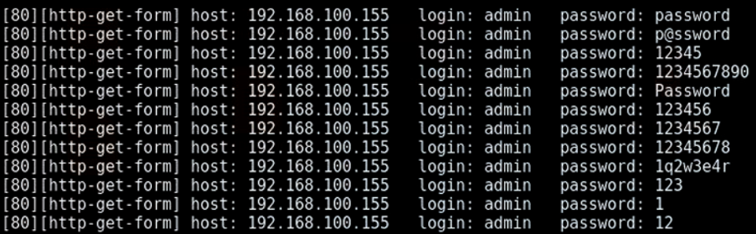
What is a Brute Force Attack?
A brute force attack is a form of password attack where the attack attempts to guess a password by trying many passwords in the attempt to guess the correct password
Notice all the passwords being used in hopes of finding the right password for the system

Slide 5
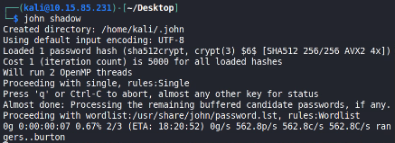
The Brute Force Lab
Setup Environment
Create example users
Set example passwords
Locate password file
Change Permissions
Launch the Attack
More Hashes
Observe results

Slide 6
Setup Environment
Log into your range
Open the Kali Linux Environment
You should be on your Kali Linux Desktop

Slide 7

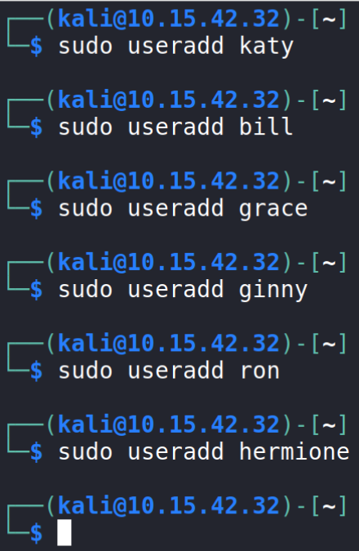
Create Users
In your Kali VM open a terminal by clicking on the terminal icon at the top left corner
Create a user on the system:
sudo useradd katy
This command creates a user named “katy”
Create additional users by using the following command:
sudo useradd bill
Create at least 3 users
Remember the users' names - you will need these to set passwords for them
Adding users to a system

Slide 8
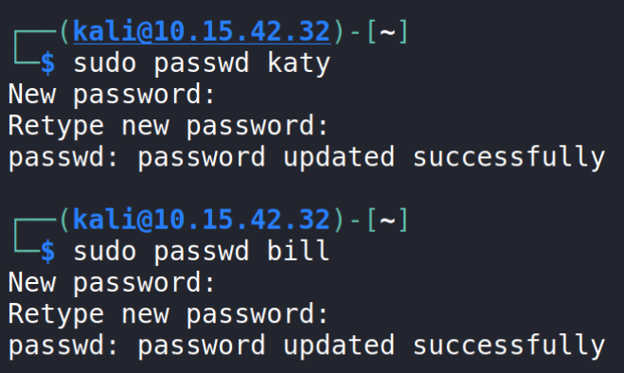
Set Passwords
Use the following command to set a password for each account:
The following command starts the prompt to set a password for the user katy
sudo passwd katy
Enter the password at the prompt “Enter new UNIX password:”
Set the password to be progressively difficult like the first with 3 characters, the next with 4, then 5,…
Repeat this step for all user accounts you created.
Adding passwords to users

Slide 9
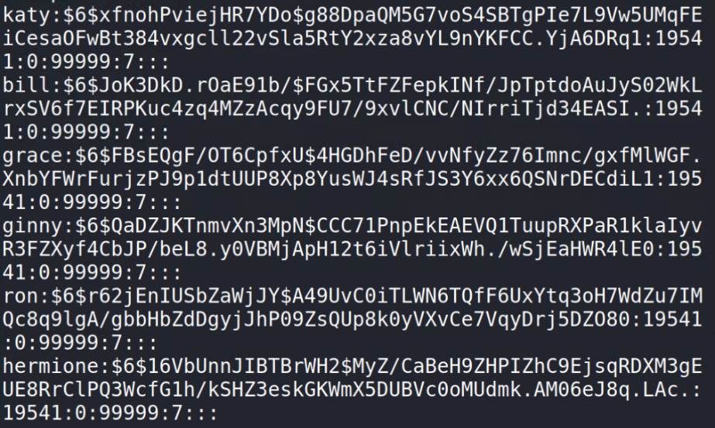
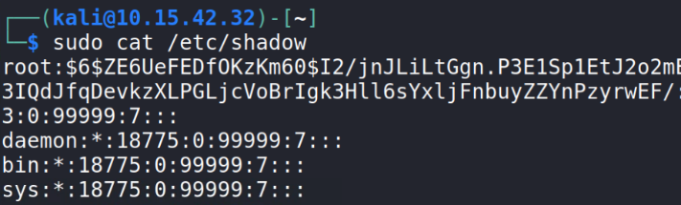
Locate Hashed Passwords
If you see a $y$ instead of $6$, make sure to pay attention to the note on slide 12
Display the hashed passwords:
sudo cat /etc/shadow
Passwords are stored in the shadow file located in the /etc directory

Slide 10
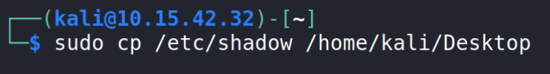
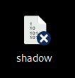
Move Hashed Passwords
Copy the shadow file to your Desktop using the following command:
sudo cp /etc/shadow /home/kali/Desktop
Verify the shadow document appears on the Desktop

Slide 11
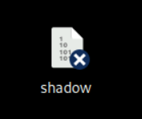
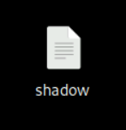
Change Permissions
Navigate to the Desktop
cd Desktop
Change the permissions on the shadow file
sudo chmod 777 shadow
Verify the shadow document appears on the Desktop
Verify the blue icon is removed from the shadow document

Slide 12
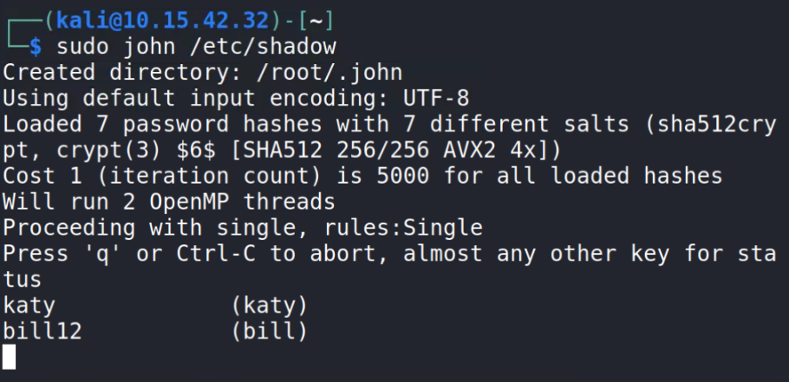
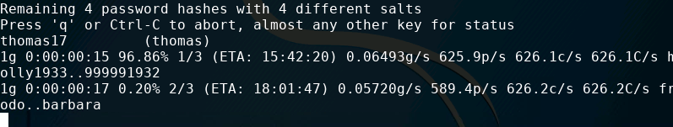
Launching the JTR Attack
Please Note: If you don’t see the $6$ with the loaded passwords, try the following:
john shadow --format=crypt
In order to launch the attack, use the following command:
john shadow
This will run John the Ripper on the shadow file and start working to crack the passwords
Press space while the attack is working to see what passwords John the Ripper is currently trying
Note this will take some time, depending on the strength of the passwords

Slide 13

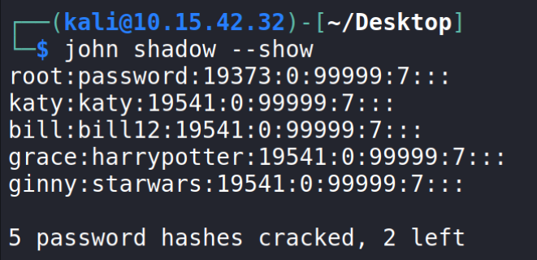
Seeing the Results
Notice that a found password will display the result while JTR is running
The following example found “thomas17” to be the password for the user “thomas”
Not a very secure password was it?
You can wait for JTR to finish, or press CTRL+C to stop the attack.
The following command will show all the passwords that have been solved
john shadow --show

Slide 14
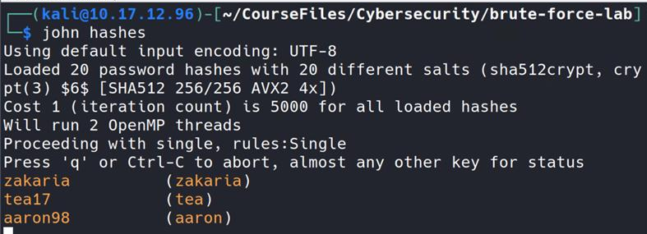
More Hashes
Open a new Terminal and navigate to the lab folder
cd /home/kali/CourseFiles/Cybersecurity/brute-force-lab
Display the hashes
cat hashes
Notice there are 20 password hashes
Crack the hashes
john hashes

Slide 15
How to Defend Against a Brute Force Attack?
Strong Passwords
Why is a longer password stronger? (D0e5 w31rd sp3LLing M4tt3r?)
Why were some passwords solved before others?
Increasingly longer delay between failed attempts
Slow down the attacker. (10s, 15s, 30s, 45s, 1minute between attempts.)
Lockout after __ failed attempts
Account will eventually lock. User will need contact support to regain access.
Two-Factor Authentication
Why would these help secure your password?
What are some other ways of defending against a brute force attack?

